Slide 1
Subtopic N2.8 – Money Problems Involving Addition and Subtraction
LEARNING OUTCOME: To apply addition and subtraction of decimals to money problems
Objectives:
Keywords:
Addition
Subtraction
To calculate basic addition and subtraction problems involving money
To calculate multi-step money problems, involving change and savings
Introduction – Read and annotate:
Adding and subtracting money is a real-life application of adding and subtracting decimals. In this
subtopic, you will use your knowledge of this. Remember that we use two decimal places in money.
Definition
Currency is the type of money that a country uses. It can be in the form of coins or bank notes.
Characteristics
Each coin or note has a specific value written on it, such as £1, £5, or £10. That value tells you how much it's worth.
Most currencies in the world have two decimal places, but some have more and some have less.
Examples
Currency
Non - Examples
This is how we write amounts of money:
£15
£0.86
£7.03
We do not write amounts of money like this:
£3.10
£165
£7.03p
£8.4
£0.9
£0.06p
£82.36
6p
35p
£1 000 000.56
Addition with money, working in both pounds and pence.
Example 1 - I do…
Example 2 – We do…
Example 3 – You do…
Steps | Sarah spends a £7.40 in one store and £2.99 in another store. How much money has she spent in total? | George buys a vest for £2 and a pair of sunglasses for £4.20. How much has he spent in total? | Adil buys a t-shirt for £3.98 and a pair of sunglasses for £4.20. How much has he spent in total?
1. Line up the correct place value.
2. Add the values together.
£10.39
£6.20
£8.18
Example 4- I do…
Example 5 – We do…
Example 6 – You do…
Steps | Amira finds 74p in her purse. She finds 48p on the table. How much money has she found in total? Give your answer in pounds. | Fahad puts 39p into a charity collection tin. Ella puts 58p into the same tin. There was already £1.58 in the tin. How much money is now in the tin? | Jozef buys an apple for 65p, a loaf of bread that costs £1.19 and a yoghurt for 83p. How much did Jozef spend in total?
1. Line up the correct place value.
2. Add the values together.
£1.22
£2.55
£2.67

Slide 2
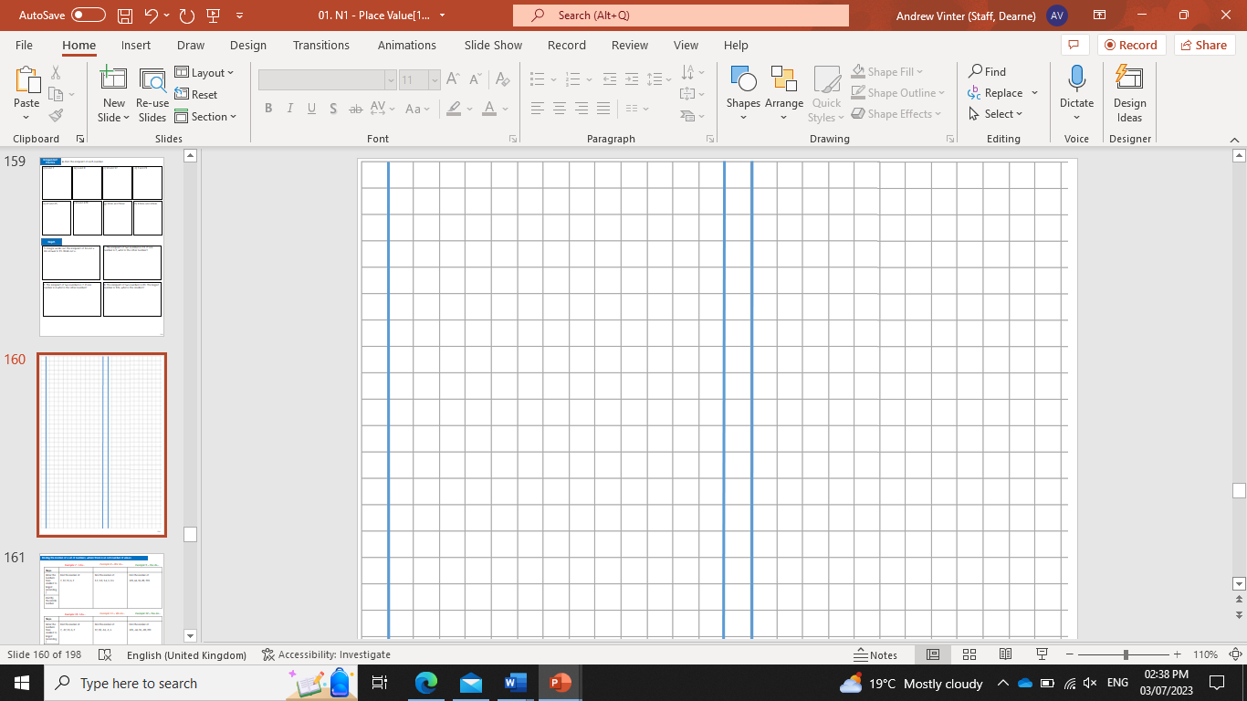

Independent Practice
1. Complete the following money problems:
a) | b) | c)
Jack had a bank balance of £7.20. He receives £1.40 from his father and puts it into his bank account. What is Jack’s new balance? | Lilian has £4.25 in her purse. She puts another £2.53 into the purse. How much is in Lilian’s purse altogether? | Marco buys a pizza for £5.19. He also buys fries for £3.73. How much did Marco spend in total?
d) | e) | f)
Faizal gives £2.62 to his sister and £2.83 to his brother. How much money did Faizal give away? | Hafsa bought a cinema ticket for £5.86. She then bought a drink for £3.47. How much did she spend altogether? | Henry finds 67p in his bedroom and 39p in the kitchen. How much money did he find in total?
g) | h) | i)
Georgina earns money from completing surveys. She earned 96p for taking survey A, 45p for taking survey B and £1.24 for taking survey C. How much money did she earn in total? | Eric bought a carrot for 45p, an orange for 58p and a butternut squash for £2.73. How much did Eric spend altogether? | Alicia bought a t-shirt for £8.50 and some shorts for £15.66. The carrier bag cost 45p. How much did she spend in total?
£8.60
£6.78
£8.92
£5.45
£9.33
£1.06
£2.65
£3.76
£24.61
2. Complete the following bar models:
a)
b)
£3.82
£2.94
89p
£2.05

Slide 3
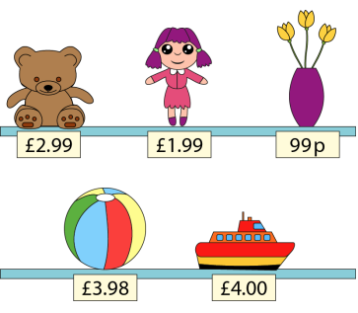
3. Complete the following money problems:
 | a)
 | Find the total cost of the doll and vase.
 | b)
 | Find the total cost of the teddy, vase and ball.
Jim looks at the items for sale and chooses some to buy with his pocket money. Which items did he buy if he spent:
c) | d)
£4.98? | £4.97?
e) Could he spend £5.98?
£2.98
£7.96
Teddy and doll
Vase and ball
No, to get the 98p you would have to use either:
£3.98 and £2, but there isn’t an item for £2 or items that add to £2
Two of the items ending in 99p, but no items fit with those to make £5.98

Slide 4
Subtraction with money, working in both pounds and pence.
Example 7 - I do…
Example 8 – We do…
Example 9 – You do…
Steps | Jenny has £7.40. Daniel has £2.30. How much more money does Jenny have compared to Daniel? | Vanessa has £9.40. She spends £2.32 in one store and 45p in another store. How much money does she have left? | Lucas had £5.40 in total. He gave £2.35 to a friend and spent 84p at the shop. How much money does he have left?
1. Line up the correct place value.
2. Add the values you are going to subtract, then carry out the subtraction.
£5.10
£6.63
£2.21
Independent Practice
4. Complete the following money problems:
a) | b) | c)
Red trainers cost £12.75 and blue ones cost £27.40. How much more do the blue ones cost than the red ones? | I need £12.50 to enter a swimming competition, but I only have £7.08. How much more money do I need? | The game I want to buy costs £29.50. I have saved £18.94. How much more do I need to save before I can buy the game?
d) | e) | f)
Paul buys a book that costs £6.89 and pays with a £10 note. How much change should Paul get? | The class has raised £100 to spend on a party. They spend £25.49 on pizzas, £13.85 on drinks and £18.75 on decorations. How much do they have left to spend on entertainment? | Maxine buys 3 magazines that cost £1.99, £2.45 and £3.70. She pays with a £50 note. Work out how much change she should receive.
£14.65
£5.42
£10.56
£3.11
£41.91
£41.86

Slide 5





g) | h) | i)
Tilly has £61. Georgina has 14p less than Tilly. How much money does Georgina have?
Mohammed has £4.78. He spends £2.56, 18p and 78p. How much money does he have left?
Emily has £6.86. She gives £1.24 to Matilda and 79p to Sophia. How much money does she have left?
£60.86
£1.26
£4.83
5. Complete the following bar models:
a)
b)
£1.60
£2.15
c)
d)
£41.91
£7.55
e)
f)
£34.65
£18.84
£41.91
£12.05
£3.76
6. Mark each calculation with a tick or cross:
£5.00 - £2.30 = £3.70 | X
£10.00 - £1.70 - £8.30 | ✓
£3.90 + £1.10 = £5.00 | ✓
£7.60 + £3.40 = £10.00 | X

Slide 6
7. Fill in the missing numbers:
a) | b) | c)
£4.86 + = £7.85 | + £3.99 = £8.85 | £3.97 = + £1.98
d) | e) | f)
£4.97 = £2.99 + | £10 - = £8.80 | £5.00 - = £1.01
£2.99
£4.86
£1.99
£1.98
£1.20
£3.99
Finding original amounts of money
Example 10 - I do…
Example 11 – We do…
Example 12 – You do…
Steps | Maryam spends 75p on a coffee. She has £1.23 left. How much money did she have originally? | Peter has £5.40 left after spending £7.75 in one store and £4.69 in another. How much money did Peter have originally? | Sally spends £4.50 on a sandwich and 96p on a packet of crisps. She has £12.30 left. How much money did Sally have originally?
Add what has been spent onto the amount they have left.
£1.98
£17.84
£17.76

Slide 7
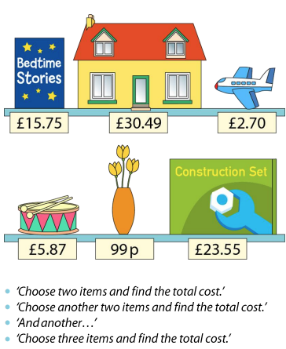
Independent Practice
8. Complete the following problems:
 | a)
 | Seb bought the toy house. He now has £12.70 left. How much money did he have to start with?
 | b)
 | Teddy bought the bedtime stories book. He now has £3.89 left. How much money did he have to start with?
c) | d)
Mary bought the vase. She now has £2.44 left. How much money did she have to start with? | Khalood bought the vase and the drum. She now has £4.52 left. How much money did she have to start with?
e) | f)
Alex had £3.35 left after buying the aeroplane, the construction set and the house. How much money did they have to start with? | Sam had £1.85 left after buying the drum, the bedtime stories book and the aeroplane. How much money did they have to start with?
£43.19
£19.64
£3.43
£11.38
£60.09
£26.17

Slide 8
Multi-step problems involving addition and subtraction of money
Example 13 - I do…
Example 14 – We do…
Example 15 – You do…
Steps | Sarah has £9.40. She spent £2.30. She was then given £4.50 by her mother. How much money does she have now? | Elijah has £9.40. He spends £5.50. He is then given an extra £14. How much money does he have now? | Arlo has £9.41. He spends £5.59. He is then given an extra £11.39. How much money does he have now?
Subtract any amounts spent and add on any amounts gained.
£11.60
£17.90
£15.21
Independent Practice
9. Complete the following problems:
a) | b) | c)
Abi has £12.86. She paid £4.32 for a sandwich. She was then given £5.20 pocket money. How much money does she have now? | Harry has £31.26. He paid £8.62 for a toy. He was then given £3.86 pocket money. How much money does he have now? | Fern has £14.31. She paid 76p for some sweets. She was then given £3.56 pocket money. How much money does she have now?
d) | e) | f)
Maddison has £9.74. They paid £1.42 for a drink. They were then given 87p. How much money do they have now? | Matilda has £91.43. She spends £15.89. She wants to reach her saving goal of £100. How much more money does Matilda need? | Skye has £76.52. She spends £17.81. She wants to reach her saving goal of £150. How much more money does Skye need?
£13.74
£26.50
£17.11
£9.19
£24.46
£91.29

Slide 9
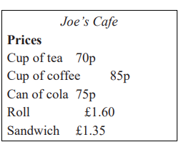
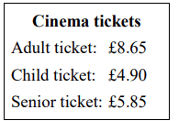
Mixed money problems: applying all previous skills
10. The cost of items at Joe’s café are shown on the menu below:
 | a) | b)
 | Jonathan buys a can of cola and a roll. Work out the total cost. | Sachin buys a cup of tea, a cup of coffee and 2 sandwiches. Work out the total cost.
c) | d) | e)
Kim buys a can of cola, a cup of coffee and a sandwich. She pays with a £5 note. Work out how much change she gets. | Calculate the difference in price in Jonathan and Sachin’s orders from part a) and b). | Jermaine bought a roll and a cup of coffee. His change was £7.55. How much money did he have to start?
£2.35
£4.25
£2.05
£1.90
£10.00
11. Farah buys: 2 pens at 84p each 3 folders at £1.35 each 1 pencil case at £1.49 She pays with a £10 note. Work out how much change Farah should get from £10. | 12. Tony buys one child ticket and one senior ticket. Work out the total cost. Kamala buys one adult ticket and two child tickets. She pays with a £20 note. How much change should she get?
£10.75
£7.22
£1.55

Slide 10
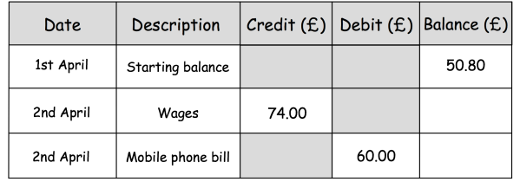
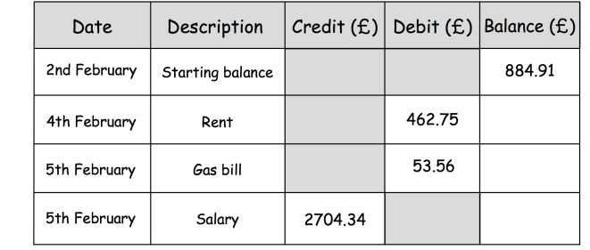
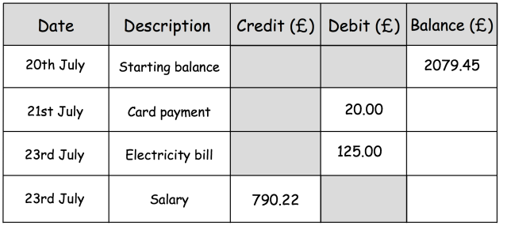
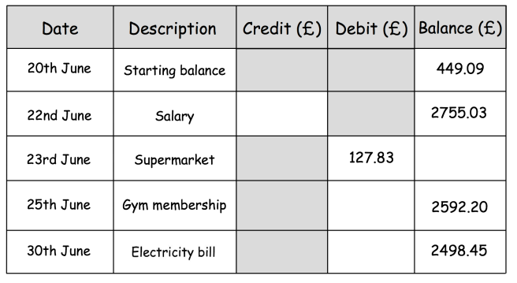
13. Fill in the missing values the following bank statements:
a)
£124.80
£64.80
b)
£422.16
£368.60
£3072.94
c)
£2059.45
£1934.45
£2724.67
d)
£2305.94
£2627.20
£35.00
£93.75

Slide 11
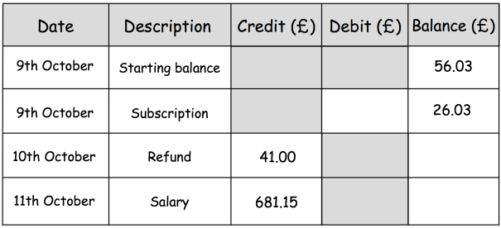
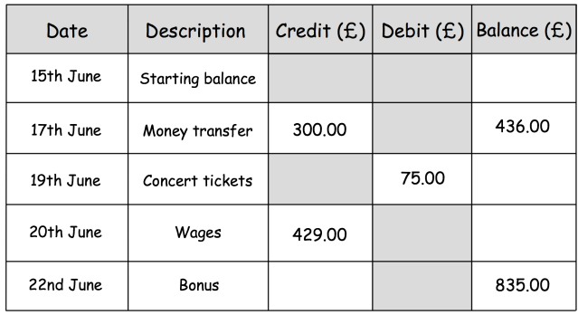
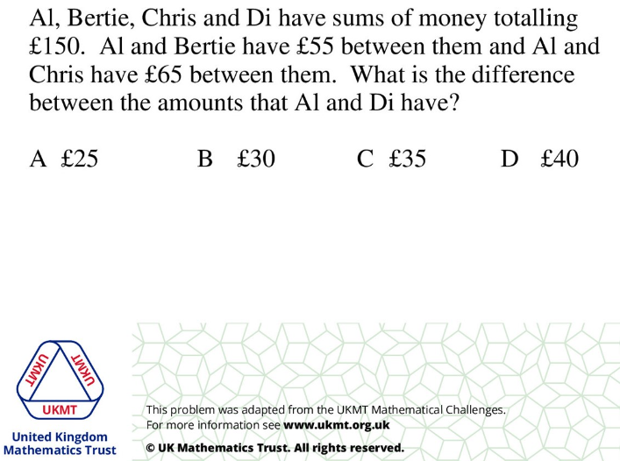
e)
£30.00
£67.03
£748.18
f)
£136.00
£361.00
£790.00
£45.00
14)

Slide 12
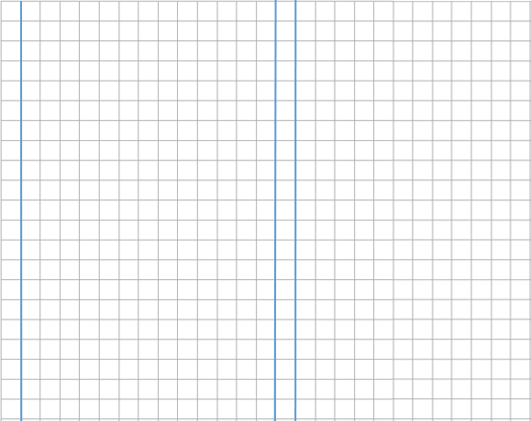
Skills Check
1. Kyle is saving money. In January, he saves £17.89 In February, he saves £9.56 In March, Kyle saves £34.78 Work out how much he has saved in total. £7.33 £52.67 £60.22 £62.23 | 2. Tom has £12.99. Nia has £37.25. How much more does Nia have than Tom? £24.26 £50.24 £25.74 £24.24
3. Ali spent £7.24. They had 83p left. How much money did they have to start with? £6.41 £8.07 £15.54 £1.06 | 4. Emma buys 2 drinks for 73p each and a sandwich for £2.18. She pays with a £5 note. How much change does she receive? £3.64 £1.36 £2.09 £2.91
5. Daniel has £185.72. He pays his phone bill of £39.99. How much more money does he need to reach his savings target of £200? £14.28 £145.73 £160.01 £54.27

